Slide 2
Objective
This project deals with the operation of doubly fed induction generator (DFIG) with an integrated active filter capabilities using grid-side converter (GSC).
To mitigate load side harmonics and extract the maximum power.

Slide 3
CONTENTS
INTRODUCTION
CONVERTERS
DESIGN OF DFIG – BASED WECS
CONTROL ALGORTHM OF THE PROPOSED WECS
SIMULINK BLOCK DIAGRAM
SIMULATION RESULTS
CONCLUSION

Slide 4
INTRODUCTION
The increase in population and industrialization, the energy demand has increased significantly. The generation of power was really a challenge now a day. If we want to increase the power generated in the conventional way. However, the conventional energy sources such as coal, oil, and gas are limited in nature. Now there is a need for renewable energy sources for the future energy demand.
Due to technical advancements the cost of the wind power production is low comparable to that of conventional power plants.

Slide 5
RES preferred because of…….
Non-pollutant.
Naturally available.
Running cost less.
This system to generate sufficient energy to attend demand at accessible prices.
Provide clean, safe and reliable electricity.
eco- friendliness
Unlimited in nature

Slide 6
CONVERTERS
GRID SIDE CONVERTER(GSC):
It is for mitigating the harmonics produced by nonlinear loads.
ROTOR SIDE CONVERTER(RSC): The main purpose of RSC is to extract maximum power with independent control of active and reactive powers.

Slide 7
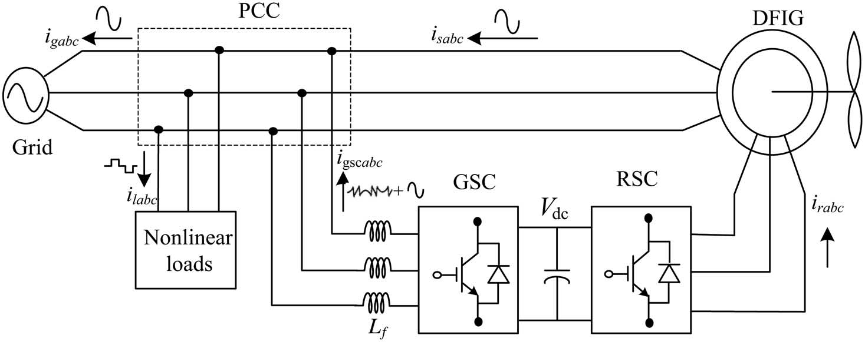
Design of DFIG – based WECS

Slide 8
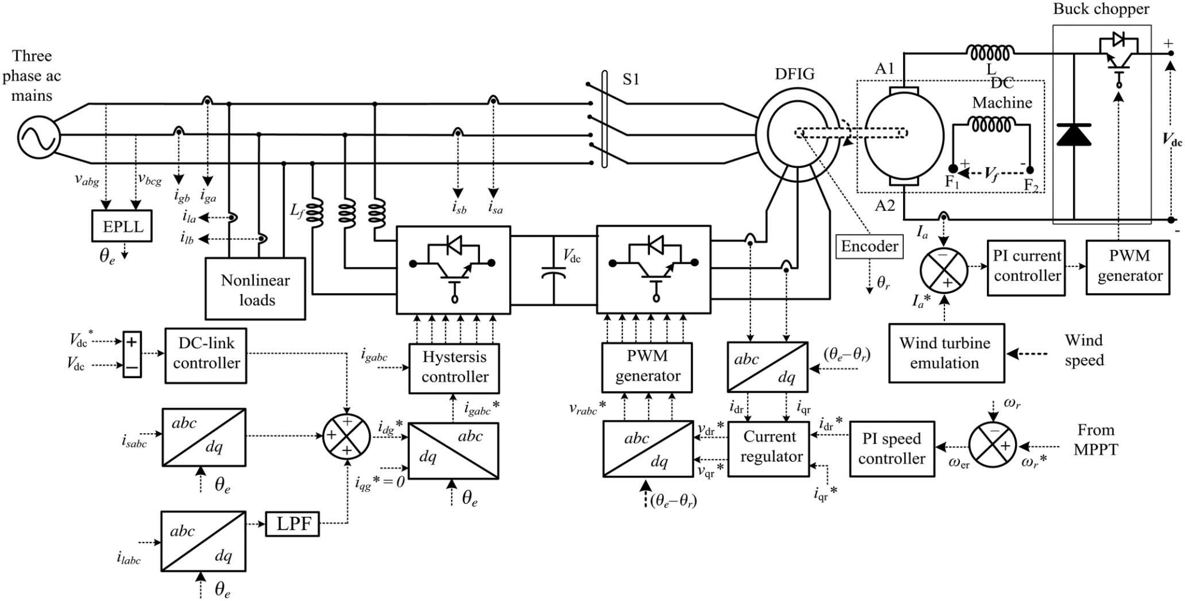
CONTROL ALGORTHM OF THE PROPOSED WECS

Slide 9
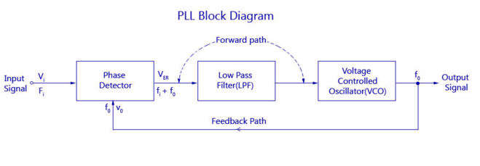
PHASE LOCKED LOOP
PLL basically consists of Three main parts
(a)phase detector
(b) LPF
(C) voltage controlled oscillator

Slide 10
Phase detector:
This comparator circuit compares the input frequency and the VCO output frequency and produces a dc voltage that is proportional to the phase difference between the two frequencies.
LPF:
A Low Pass Filter (LPF) is used in Phase Locked Loops (PLL) to get rid of the high frequency components in the output of the phase detector
It also removes the high frequency noise
It helps to control the dynamic characteristics of the whole system
Vco:
The main function of the VCO is to generate an output frequency that is directly proportional to the input voltage.
The frequency of oscillation is determined by the resistor R and capacitor C along with the voltage Vc applied to the control terminal.

Slide 11
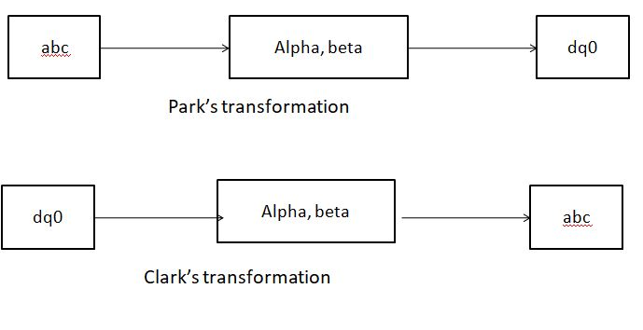
SYNCHRONOUS REFERENCE FRAME THEORY (D-Q THEORY):

Slide 12
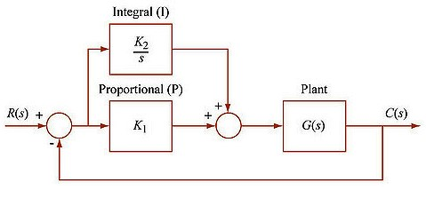
PI Controller

Slide 13
This is the combination of proportional and an integral controller the output (also called the actuating signal) is equal to the summation of proportional and integral of the error signal.
PI controller will eliminate forced oscillations and steady state error resulting in operation of on-off controller and P controller respectively.
The integral mode has a negative effect on speed of the response and overall stability of the system. Thus PI controller will not increase the speed of response.
PI controller does not have means to predict what will happen with the error in near future.

Slide 14
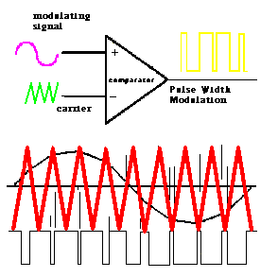
Pulse width modulation technique

Slide 15
THANK YOU

